Slide 1
Friday, October 21, 2016
Write In Your Agenda:
Write In Your Monitoring Log:
CW:
Earthquake PPT and notes
Start Pudding Lab
HW:
Get Monitoring Log signed.
Need donations of graham crackers and vanilla pudding cups.
Response to Warm-Up:
Why is it important to understand earthquakes?
You will need:
Pencil
Hand in Faults and Earth Science Pyramid worksheets

Slide 2
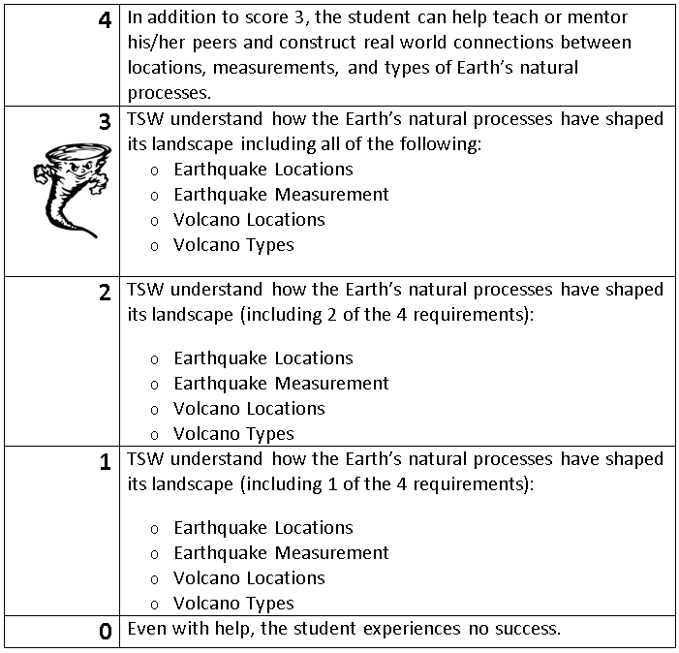
Learning Goal and Scale
TSW understand how the Earth’s natural processes have shaped its landscape (including Earthquake locations and how they are measured as well as Volcano locations and the three types).

